Slide 1
Heat Energy

Slide 2
Understand heat (thermal) energy.
TRACK WITH ME
READ WITH ME
Describe thermal energy.
Describe the effects of adding/removing thermal energy to objects, in terms of: Change of temperature, Change of state, Movement of particles and Distance between particles
Recognise and list examples of useful and wasted heat energy.
Notes:
Learning Objectives contain concepts (nouns, big ideas), skills (verbs, measurable behaviours) and sometimes context (restricting or targeting conditions).
●Example: Students will be able to describe the concept of density and apply it to floating and sinking.
Success criteria are specific measurable outcomes that if met mean that the student has met the learning objective.
Examples:
•Students will be able to compare densities of substances using mass and volume.
•Students will be able to identify whether a solid or liquid will float or sink in a liquid based on their densities.

Slide 3
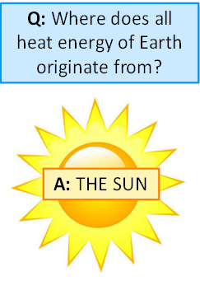
Where does all the energy on Earth come from?

Slide 4
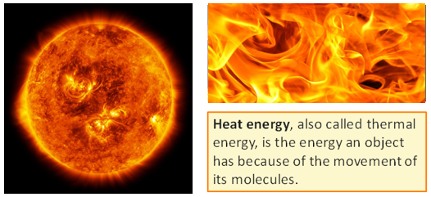
What is the sun made of?
MAKE THE CONNECTION
all heat comes the sun
The sun consists mainly of hydrogen atoms fusing two by two into helium, unleashing immense energy in the process.

Slide 5

What is Heat?

Slide 6
Useful and Non-useful Energy
DEFINITION
Thermal Energy: Thermal energy (also called heat energy) is produced when a rise in temperature causes atoms and molecules to move faster and collide with each other
Most heat energy is not useful and considered wasted energy.
List examples of heat energy that is useful and another list of heat energy that is not useful.
Useful Heat Energy | Non-Useful Heat Energy
Hair Dryer | Heat from laptop

Slide 7
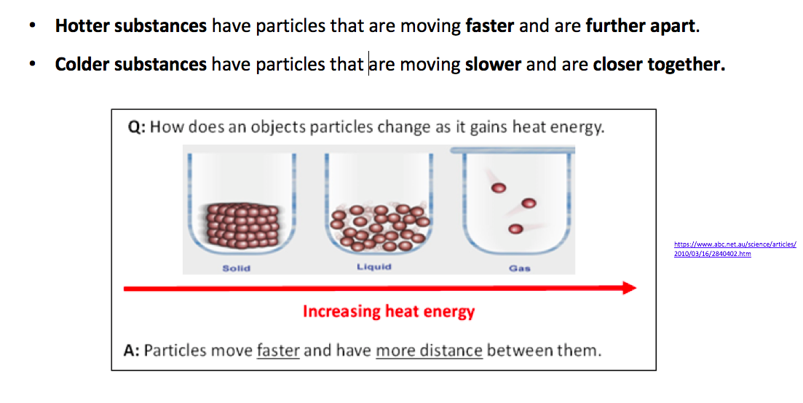
DEFINITION

Slide 8
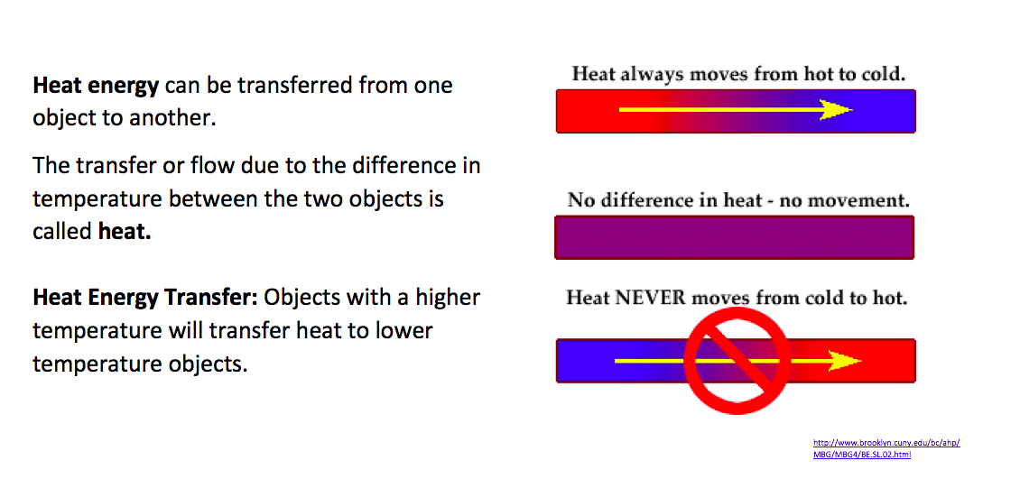

Slide 9
ACTIVITY: Thermal Energy Transfer
Hand out worksheet: Thermal Energy Transfer
GO TO: http://pbslm-contrib.s3.amazonaws.com/WGBH/conv16/conv16-int-thermalenergy/index.html - /intro
YOUR TASK: Work through the interactive and answer the questions provided.

Slide 10
Understand heat (thermal) energy.
TRACK WITH ME
READ WITH ME
DEFINITION
Define a key word in the learning objective here.
Describe thermal energy.
Describe the effects of adding/removing thermal energy to objects, in terms of:
Change of temperature, Change of state, Movement of particles and Distance between particles
Recognise and list examples of useful and wasted heat energy.
DECLARE THE OBJECTIVE
Read the learning objective to your partner.
Notes:
Learning Objectives contain concepts (nouns, big ideas), skills (verbs, measurable behaviours) and sometimes context (restricting or targeting conditions).
●Example: Students will be able to describe the concept of density and apply it to floating and sinking.
Success criteria are specific measurable outcomes that if met mean that the student has met the learning objective.
Examples:
•Students will be able to compare densities of substances using mass and volume.
•Students will be able to identify whether a solid or liquid will float or sink in a liquid based on their densities.

